Slide 1
From Tngsua to South Seas
Subtitle

Slide 2
So far, we learnt that:
Chinese community in Singapore is not homogenous
Diversity still present in food culture, customs and festivals
Complex layers of identity related to the administrative/cross administrative, and language networks in China

Slide 3
The next logical deduction will be: Chinese in China is not homogenous
Therefore, the questions we should be asking:
Who were the Chinese?
Why they came from?
Where are they going?

Slide 4
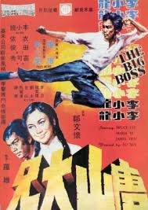
Tngsua (Hokkien\Teochew); Tangshan (Mandarin) 唐山
Not to be confused with Tangshan city in Hebei China
Common name for “China” in major southern dialects
Tng/Tang: Tang Dynasty (618-907)
Sua/Shan: mountains (territory)
South Seas 南洋: generally referring to South East Asia
https://www.mewatch.sg/watch/The-Awakening-S1-E2-42090
23:24

Slide 5
Core Ideas
Culture was never homogenous or unchanging
Migration is an on-going process

Slide 6
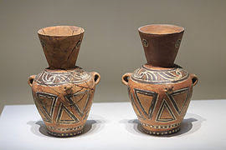
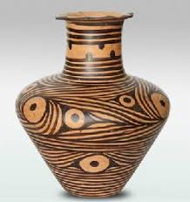
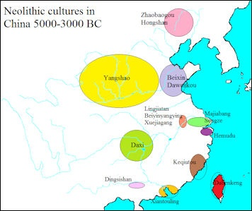
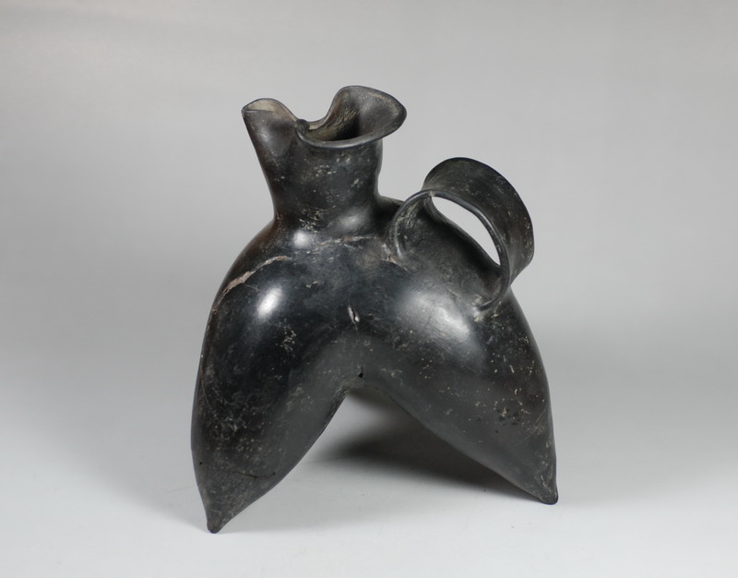
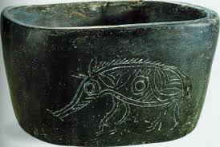
Multiple Origins 1
factsanddetails

Slide 7
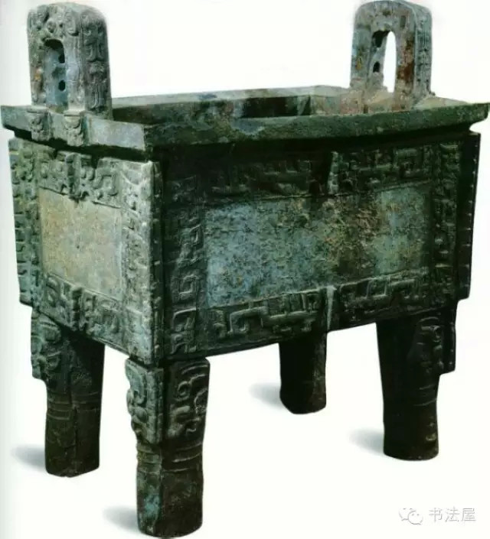
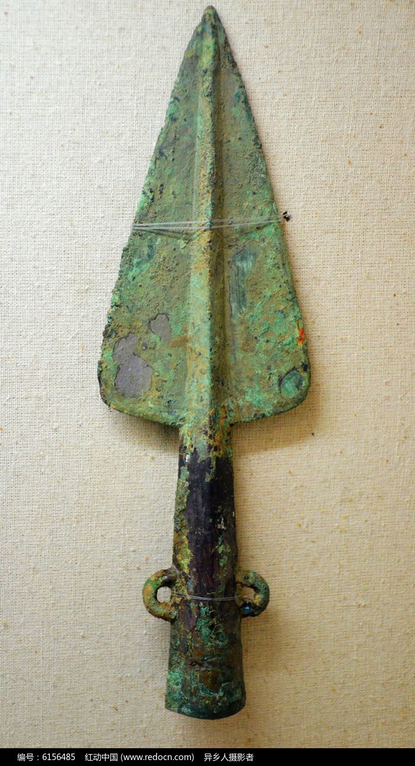
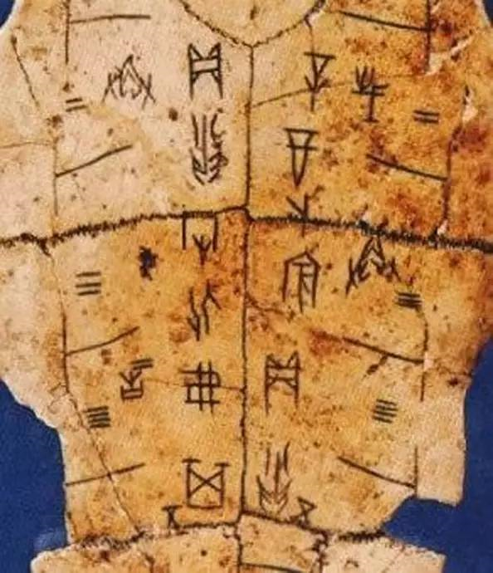
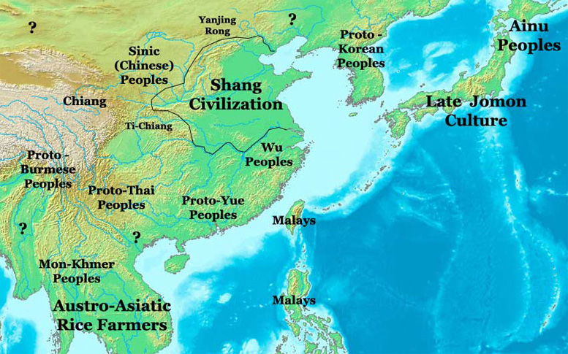
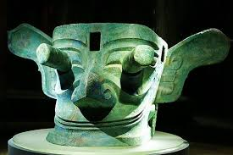
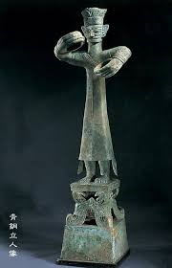
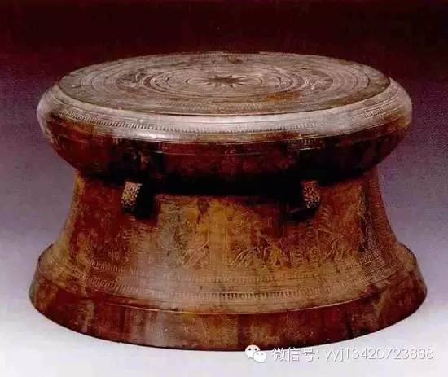
Multiple origins 2
Brian Hoffert

Slide 8
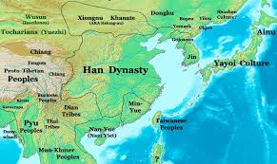
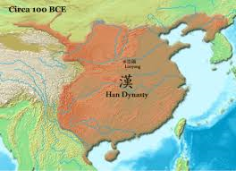
All under heaven 1 First the Qin 秦, then the Han 汉
nationsonline
206 BCE – 220 CE

Slide 9
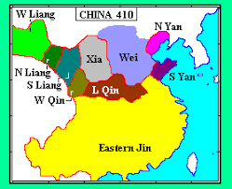
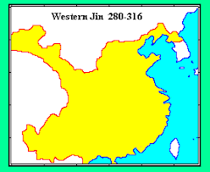
Moving south 1
Northern &
Southern Dynasties
Period
Lost of northern territories to non-Han groups.
Fled of the royal family and great clans to south China.
The succession of dynasties and great clans in the south
understood themselves as keepers of Han-ness.
Intensifying the cultural changes in south China.

Slide 10
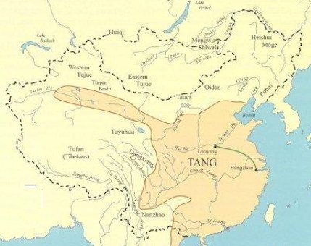
All under heaven 2 First the Sui 隋, then the Tang 唐

Slide 11
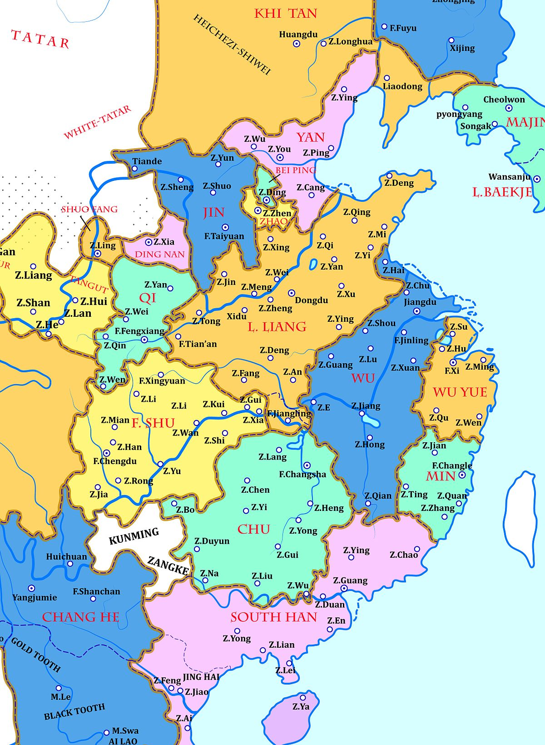
Moving south 2
Late Tang and Five Dynasties
Period.
Large influx of northern “Tang” people
To south China

Slide 12
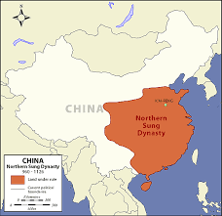
(somewhat) all under heaven 3

Slide 13
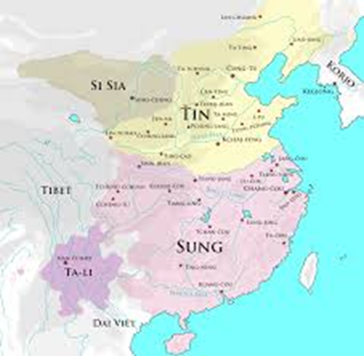
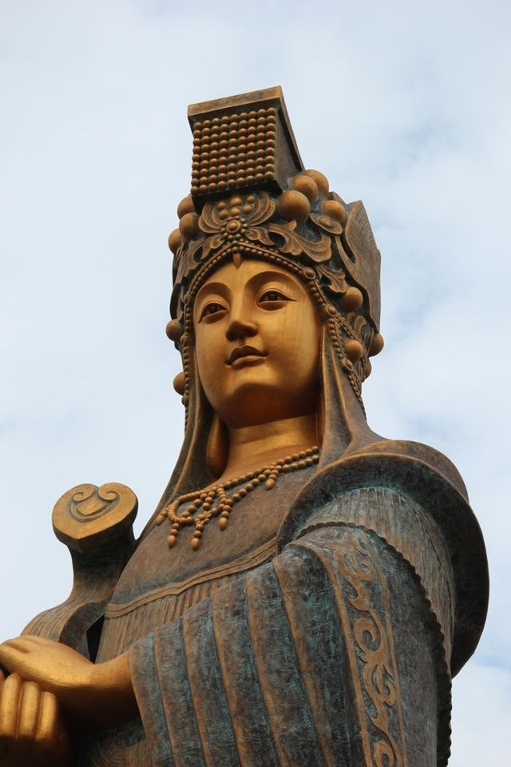
Moving south 3
Southern Song (1127-1279)
1, Development of lineage organization
Ancestral rites
Communal Property
Compiling Genealogies
2, Proliferation of religious networks
e.g. Mazu

Slide 14
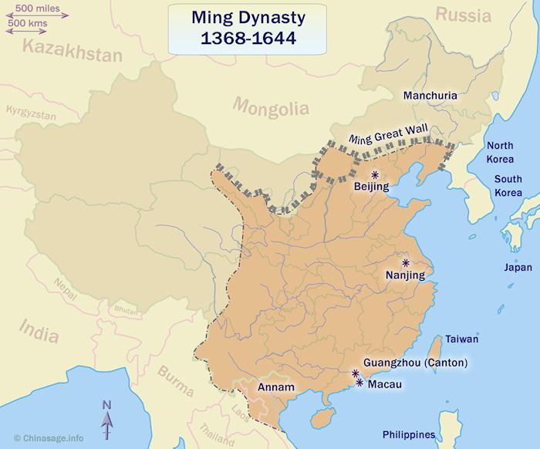
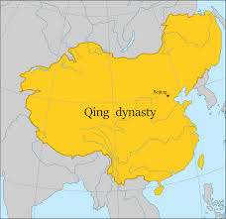
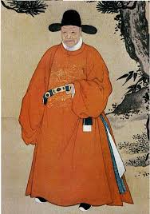
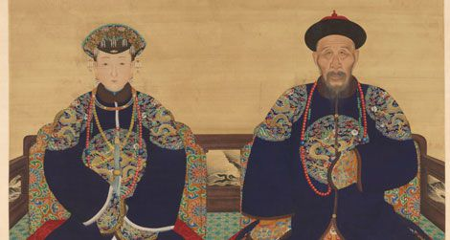
All under heaven 4
Qing
1368-1911
Southern provinces
incorporated

Slide 15
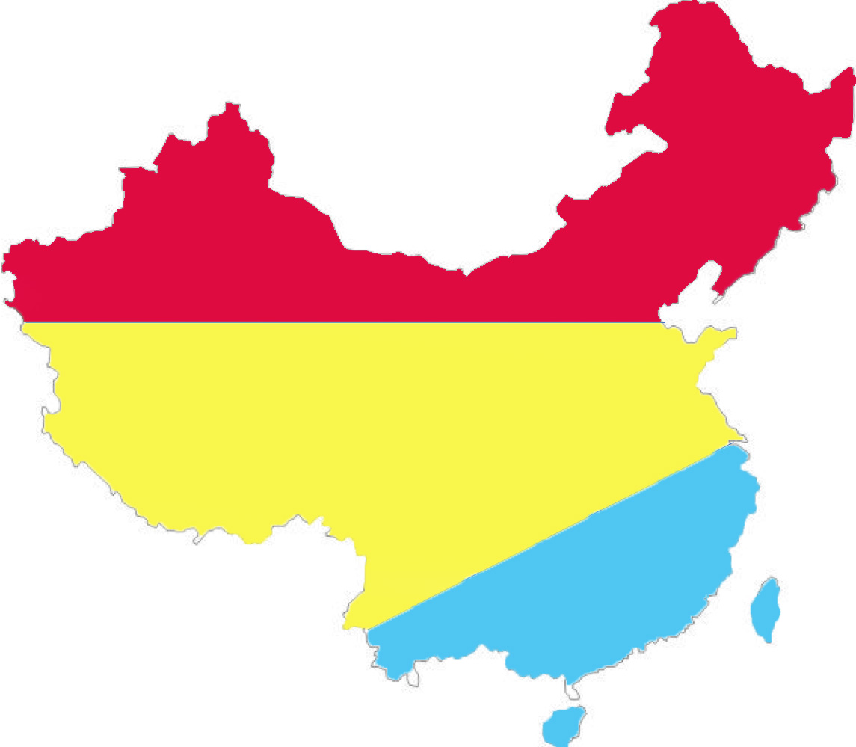
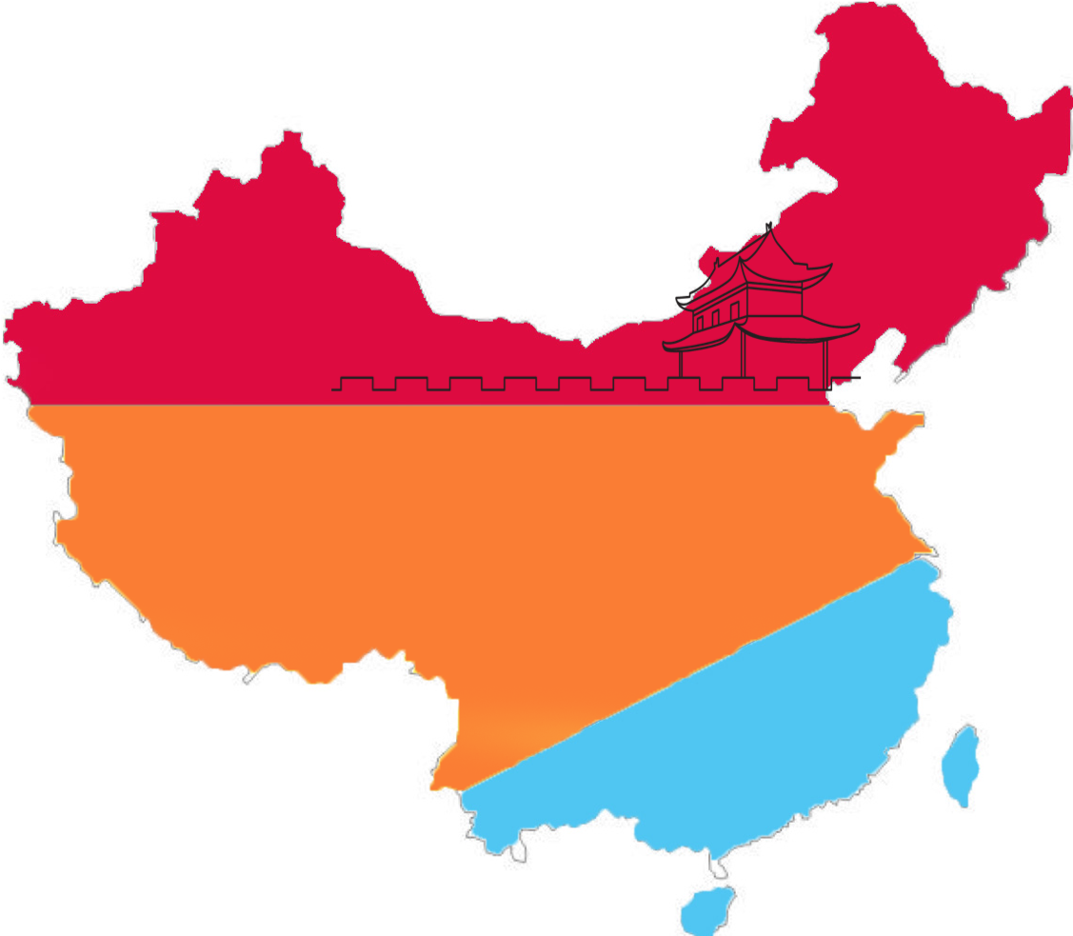
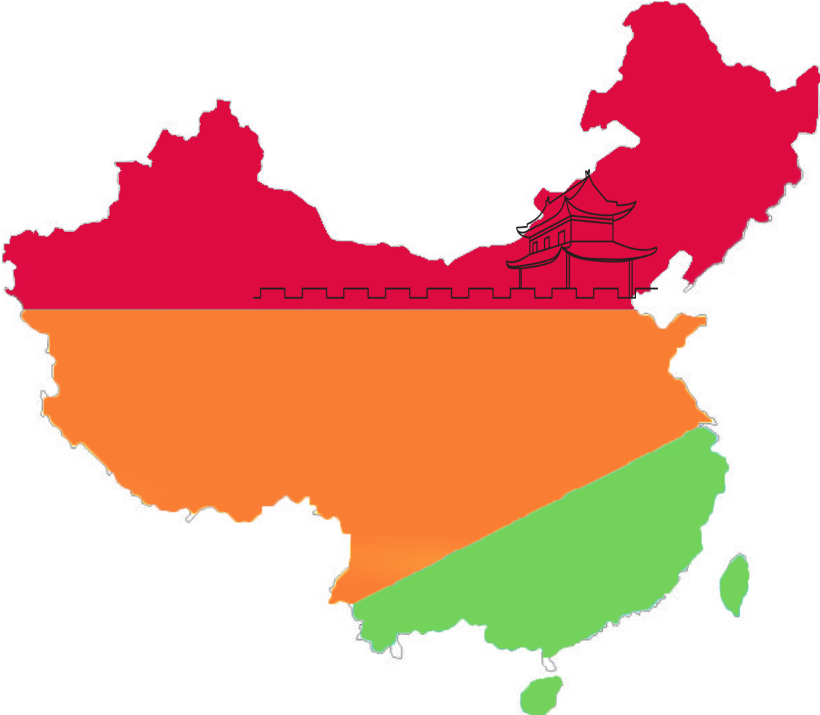
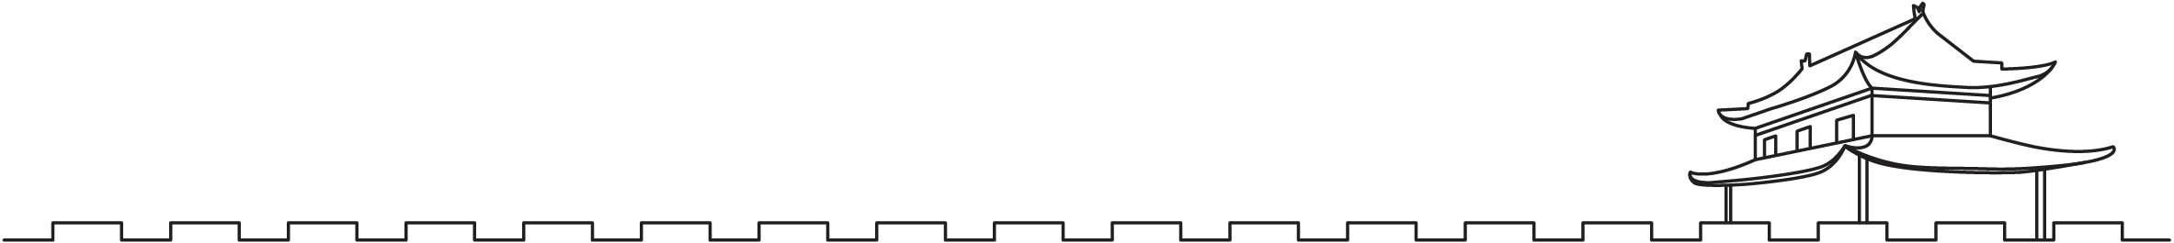
Hu
The Great Wall
Han
Hu-Han
Yue
Han-Yue

Slide 16
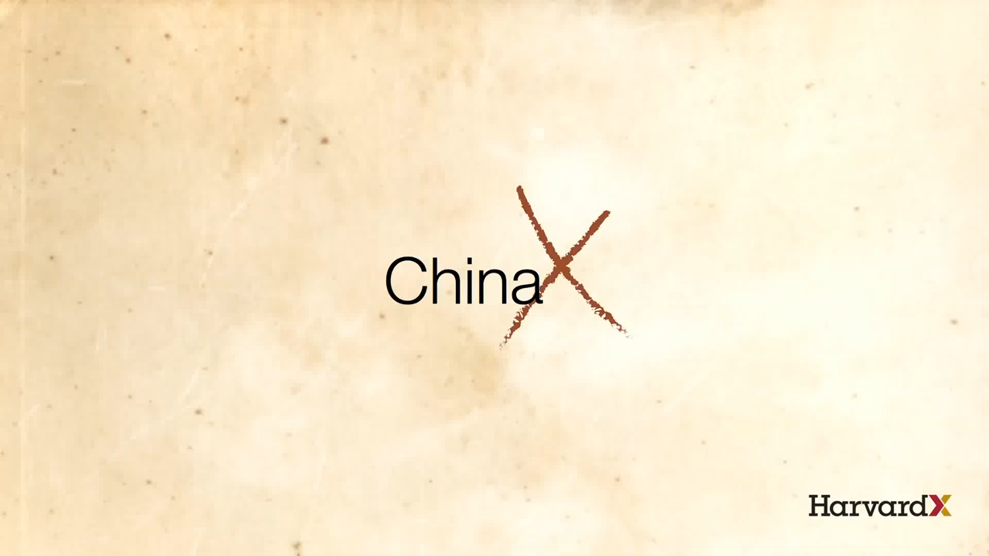
The Chinese dynasties

Slide 17
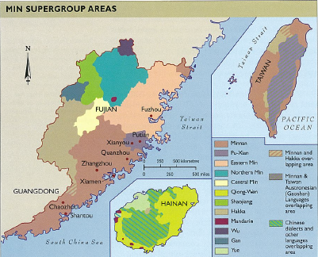
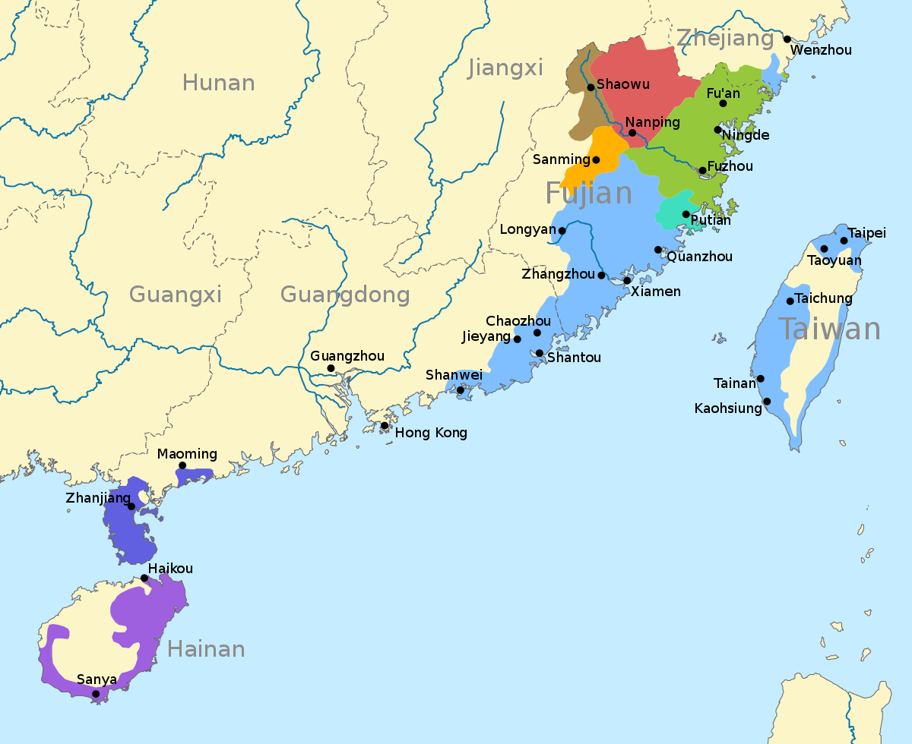
Min &
Minnan
Dialects
Min: Fujian province
Minnan: Southern Fujian

Slide 18
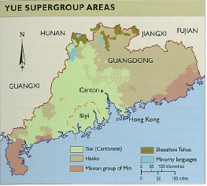

Slide 19
Different borders
Administrative borders
Province (Fujian, Guangdong etc.)
Prefecture / City (Quanzhou泉州, Zhangzhou漳州, Chaozhou潮州, Qiongzhou琼州, Guangzhou广州)
County
Culture & Linguistics “borders”
regions

Slide 20
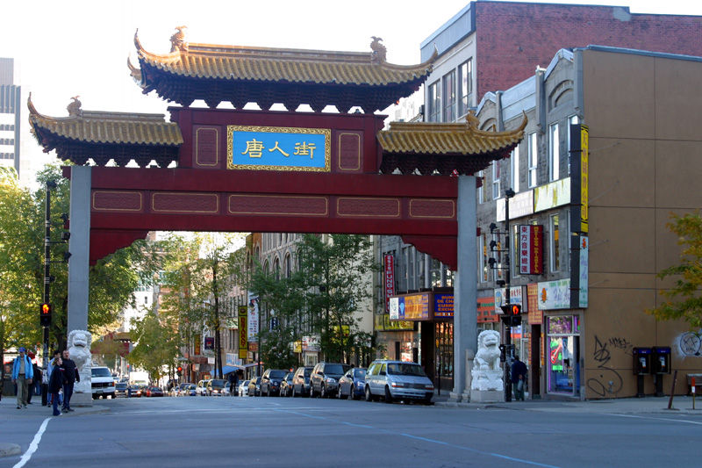
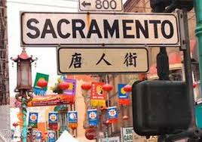
The significance of tng
1, Cultural Identity

Slide 21
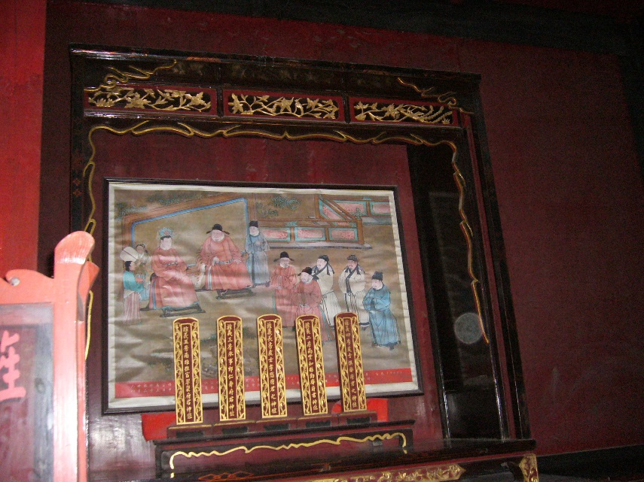
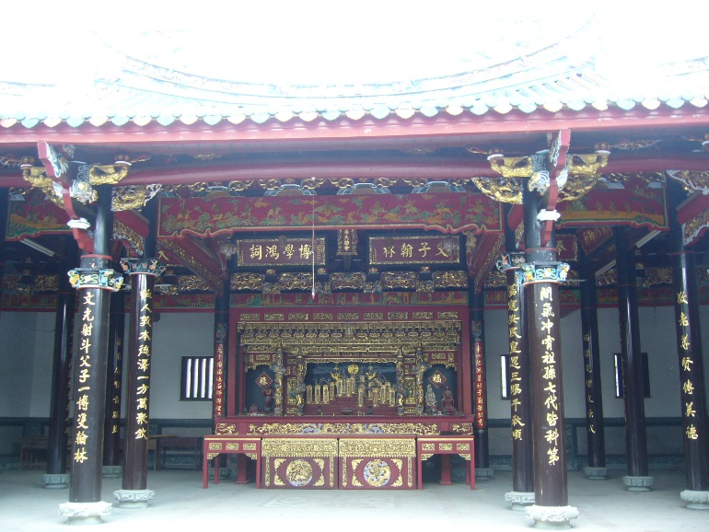
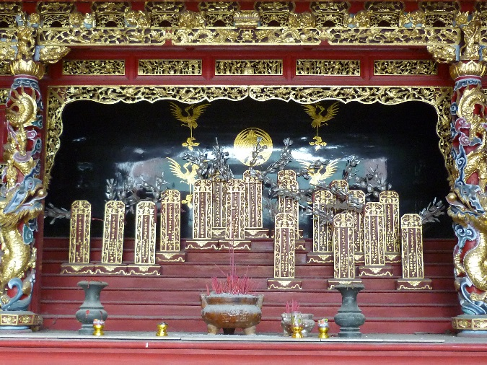
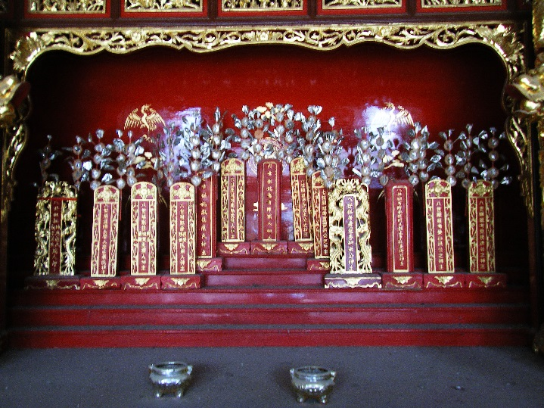
2, Family history

Slide 22
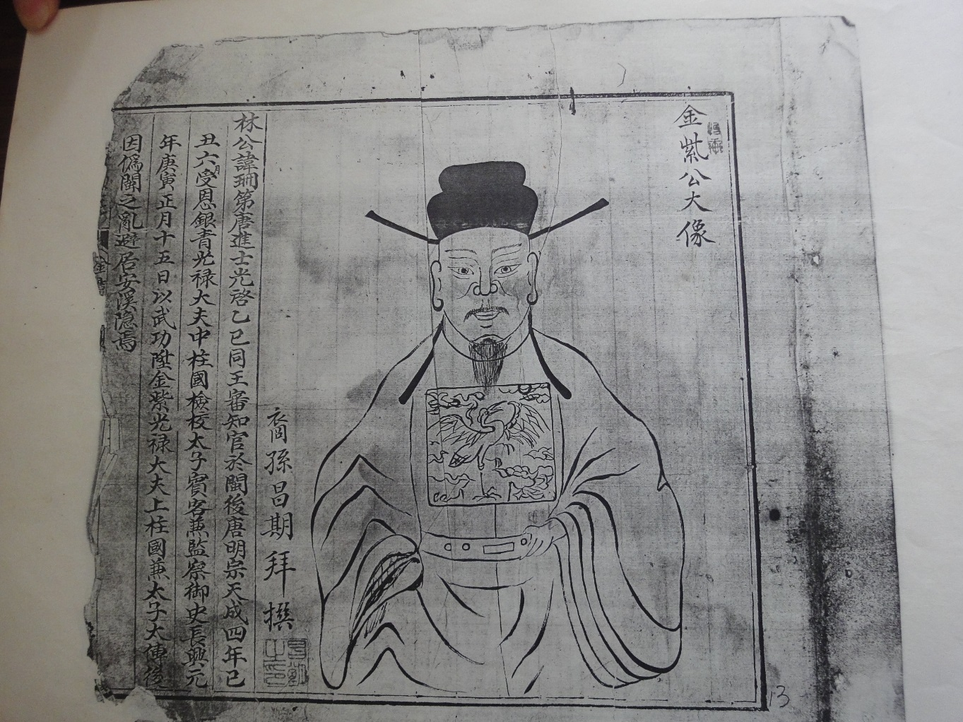
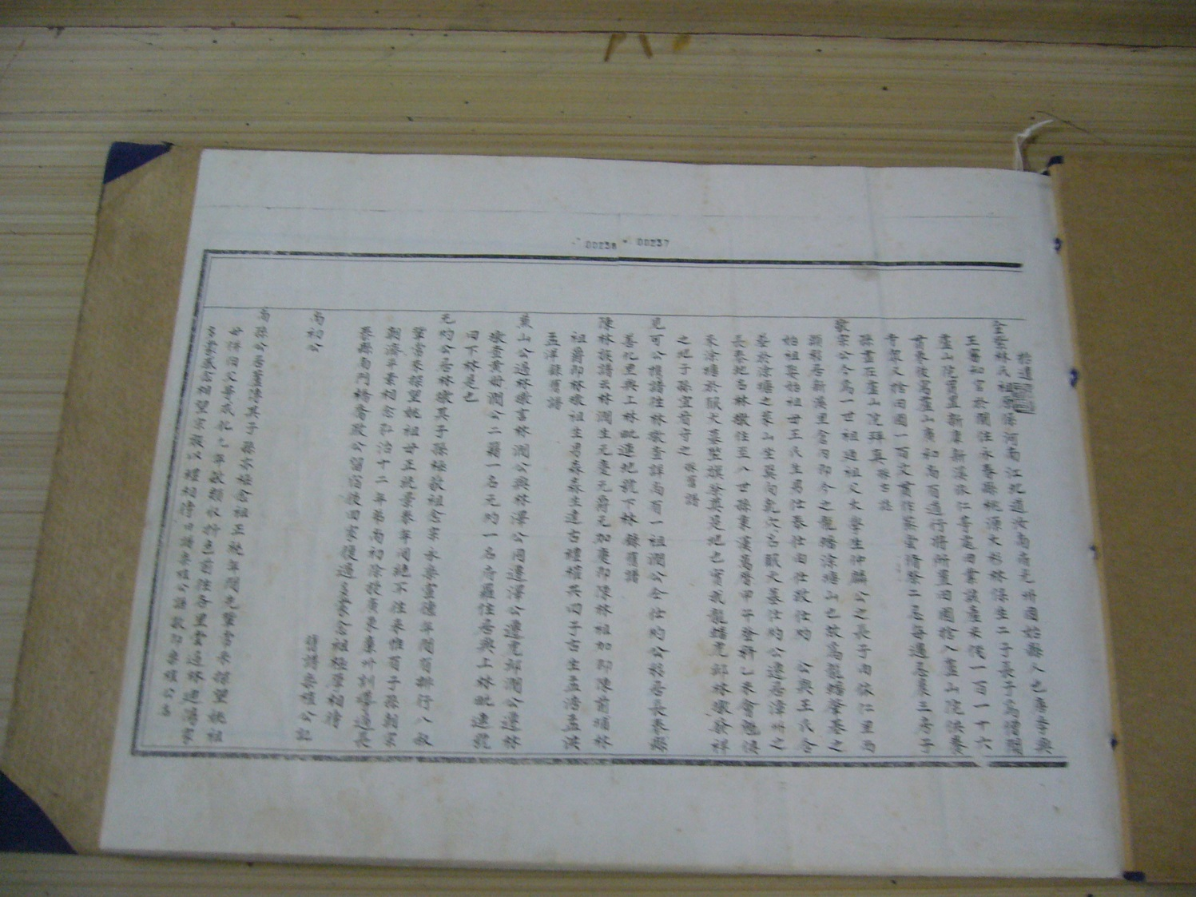
Ancestral hometown
: North China
-- Henan province –
Guangzhou -- Gushi
Migrated south during the Five-dynasties period,
and helped to established the Min kingdom

Slide 23
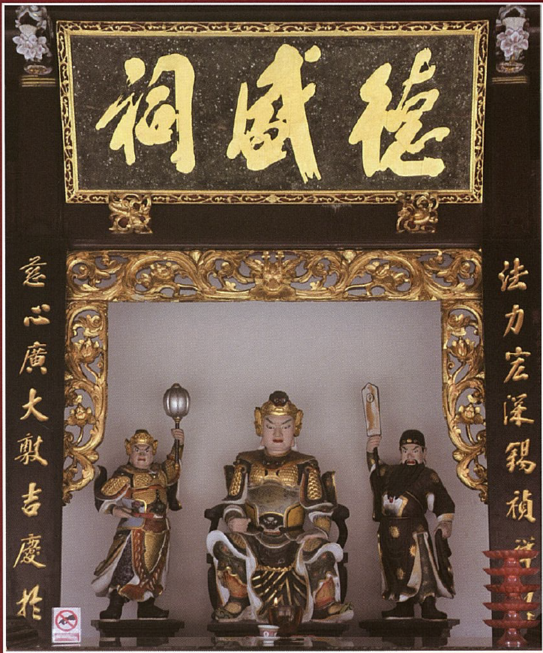
Kaizhang Shengwang – Chen Yuanguang
(开漳圣王：陈元光）
“The sagely king that civilized Zhangzhou”
Military colonization of Southern Fujian during the late Tang.
Leader canonized as a god.
Chen (Tan) groups claiming descent from common ancestor.
Developed into a regional cult：Southern Fujian, Teochew, Taiwan,

Slide 24

Moving to the uncivilized land 过番

Slide 25
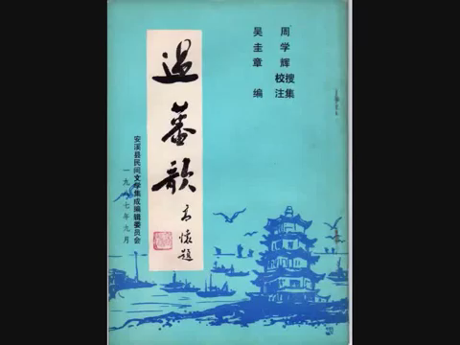
Singapore hokkien version
Seven Chinese characters per line.
@ 45th second:
“there was really no hope back at Thgsua,
therefore we have to move to the alien land (guo fan 过番) together”

Slide 26
Waves of migration
The “modern times” mentioned in the title begin (symbolically) with the year 1567, when a long-standing imperial ban on private maritime trade (a ban long ineffectual) was formally lifted.
Philip A. Kuhn, Chinese Among Others – Emigration in Modern Times.

Slide 27
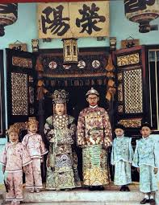
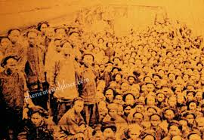
The babas and the sinkeh

Slide 28
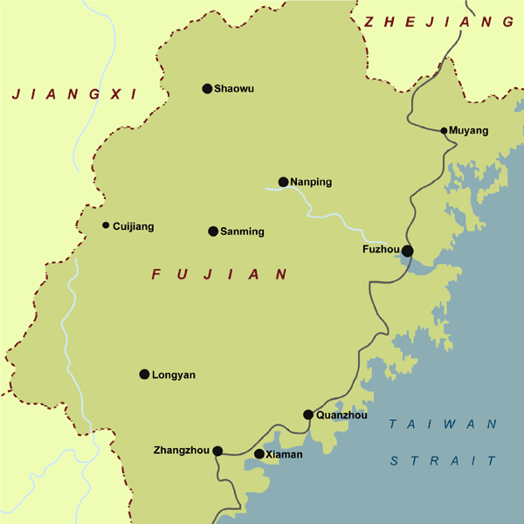
Ripples of migration
Zhangzhou was the approved port to engage in maritime trade in 1567.
Zhangzhou merchants (men!) sojourning in major Southeast Asian ports.
Fall of Ming dynasty in 1644, loyalists left and never returned to Qing China.
Married local women.

Slide 29
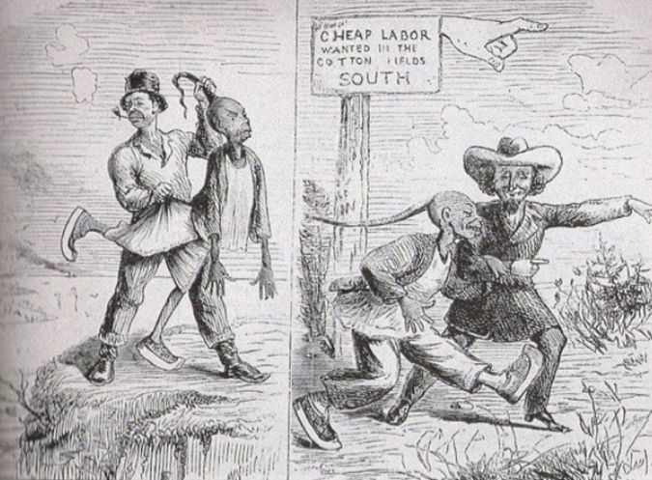
Waves of migration
Opium war 1840; Treaty of Nanking 1842.
Xiamen as one of the five treaty ports.
Xiamen was under the jurisdiction of Quanzhou.
Demand of labor in mines and plantations.
Free immigrants and forced indentured laborers.

Slide 30
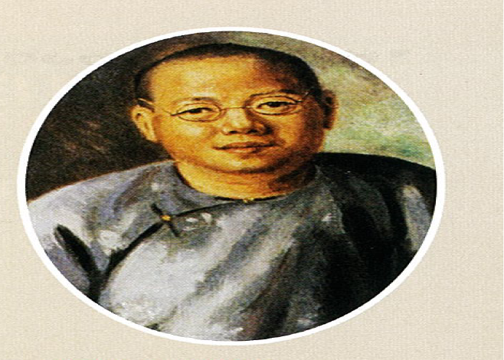
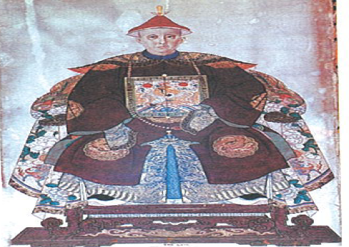

The early leaders
Tan Tock Seng (1798-1850)
Si Hoo Keh
Malacca
Straits Chinese (Nyonya - Baba)
Cheng Hoon Teng Temple (1673)

Slide 31


Slide 32



Tan Tock Seng
1798-1850
Tan Kim Ching
1829-1892
Tan Boo Liat
1875-1934

Slide 33



Thian Hock Keng Mazu – guardian of all seafarers Tianhou – Queen of Heaven

Slide 34

From temple to secular organization
1915
Regroup, drawing new constitution, and attempt to institutionalize
1916
Officially “Thian hock Keng Hokkien Huay Kuan”. First president: See Tiong Wah (1886-1940)
See Tiong Wah was born in Singapore, received his education at St Joseph Institution, great grandson of Si Hoo Keh.

Slide 35

The Rise of the Sinkeh in the new century
Tan Kah Kee (1874-1961)
Born and died in China.
Rubber King
Parallel philanthropy
Fujian
Singapore

Slide 36





1913 Chip Bee Primary
1918 Chip Bee Normal School
1921 Xiamen University
One of Tao Nan founders
Tao Nan’s chairman from 1911-1929
Assisted in establishing Ai Tong and Chong Hock Girls
Chinese High School, 1919

Slide 37
1929
New election of council members
Formation of executive council
General affairs
Education
Finance
Construction
Welfare
Formation of supervisory council
When funds were handed over, Thian Hock Keng had a cash balance of $40 000; Hokkien Huay Kuan had funds amounting about $15 600.

Slide 38
1937, Singapore Hokkien Huay Kuan
Non-profit organization
Took over all properties of Thian Hock Keng Hokkien Huay Kuan and managed all affiliated temples and cemeteries.

